Slide 1
Account
String accountNo
String ownerName
int balance
void deposit(int amount)
void withdraw(int amount)
void printAccount()
Account a1 = new Account(“111-1111”,”홍길동”,10);
Account a1 = new Account(“111-1111”,”홍길동”);
CkeckingAccount ca1 =
new CkeckingAccount(“111-1111”,”김길동”,[1000,]
”1234-1234-1234-1234”);
CheckingAccount String cardNo
void pay(String cardNo, int amount)
CreditLineAccount cla1 =
new Account(“111-1111”,”박길동”,[1000,]
”1234-1234-1234-1234”,
2200000000L);
CreditLineAccount long creditLine;
void pay(String cardNo, int amount)

Slide 2
public static void main(String[] args) {
Account a1 = new Account("111-1111", "홍길동");
CheckingAccount a2 = new CheckingAccount("222-2222", "성춘향", 2000, "1234-1234-1234-1323");
CheckingAccount a3 = new CreditLineAccount(“333-2222", “이춘향", 2000, "1234-1234-1234-9999", 10000);
a1.deposit(3000);
a2.withdraw(200);
a3.deposit(3000);
a1.printAccount();
a2.pay("1234-1234-1234-1323", 200);
a3.pay("1234-1234-1234-1323", 5000);
}
main함수 실행결과 :
계좌번호:111-1111, 홍길동님 잔액은 3000
★★★200사용되서 1600잔액★★★
카드번호가 일치하지않습니다

Slide 3
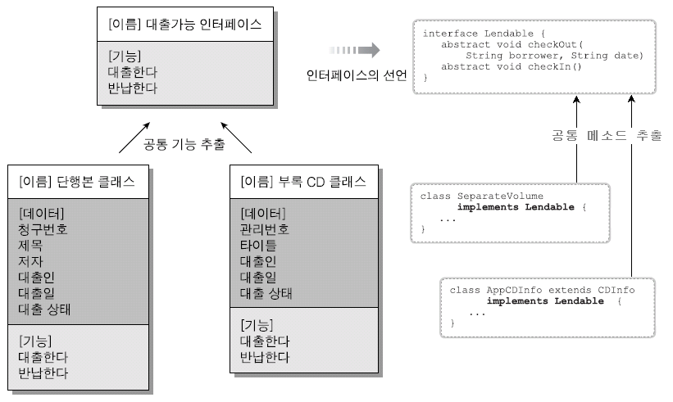
상속과 인터페이스

Slide 4
제출할 파일들 :
BookInfo.java
BookLib.java
ILendable.java
LibMain.java
콘솔실행화면캡처파일
이클립스화면캡처파일
ILendable
STATE_BORROWED=1
STATE_NORMAL=0
checkOut(String, String);
checkIn();
printState();
BookInfo
String bookNo
String bookTitle
String writer
extends
implements
Object
String bookNo
String bookTitle
String writer
String borrower
String checkOutDate
byte state
checkOut(String, String);
checkIn();
printState();
BookLib
String borrower
String checkoutDate
byte state (0, 1)

Slide 5
1:책대출 2:CD대출 3:책반납 4:CD반납 0:종료
BookInfo
String bookNo
String bookTitle
String writer
생성자
setter,getter
ILendable
STATE_BORROWED=1
STATE_NORMAL=0
checkOut(String, String);
checkIn();
printState();
CDInfo
String cdNo
String cdTitle
Sting bookNo
extends
implements
implements
extends
BookLib
String borrower
String checkoutDate
byte state (0, 1)
CDLib
String borrower
String checkoutDate
byte state (0, 1)

Slide 6
main함수
BookLib[] books = { new BookLib("a01", "java", "신용권"),
new BookLib("a02", "jsp", "아무개"),
new BookLib("a03", "Oracle", "홍길동"),
new BookLib("a04", "mySQL", "이마이"),
new BookLib("a05", "Servlet", "서블리") };
int fn, idx;
do {
System.out.print("1:책대출 | 2:책반납 | 0:종료 ?");
fn = sc.nextInt()
switch(fn){
case 1: //책대출
case 2: //책반납
}
}while(fn!=0);
// books 과 cds 배열의 상태를 출력

